Slide 1
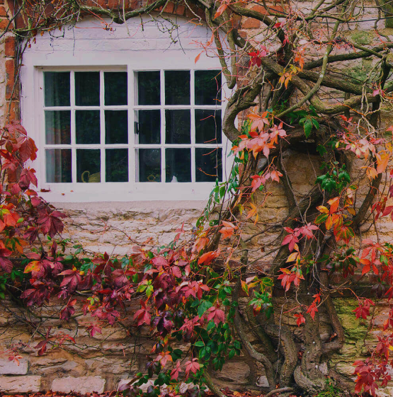
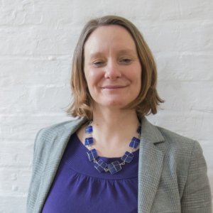

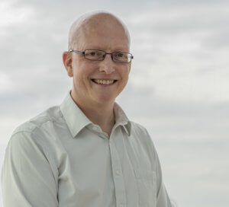



Making our homes fit for the future
Dr Katherine Adams
Jon Bootland
Dr Kerry Mashford OBE

Slide 2
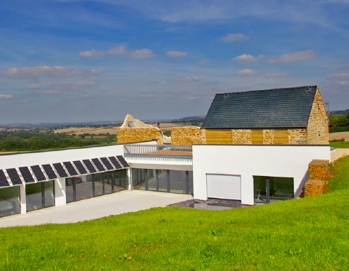

Jon Bootland Passivhaus Trust
Passivhaus:
An introduction
Underhill House: Seymour-Smith Architects
Passivhaus Trust The Foundry, 5 Baldwin Terrace, London N1 7RU Tel: 0207 704 3502
Email: info@passivhaustrust.org.uk Web: www.passivhaustrust.org.uk

Slide 3

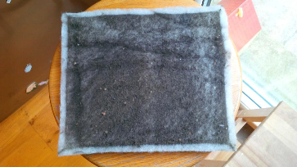
A comfort standard
From a Comfort Perspective …
Constant year round temperature (20°C)
No draughts
No overheating
No cold radiant temperature in winter (no condensation and mould growth risk)
Fresh, clean, warm air
Whole house is warm

Slide 4
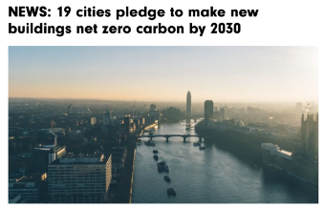
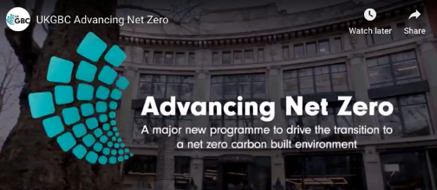
A route to Net Zero
Passivhaus Trust The Foundry, 5 Baldwin Terrace, London N1 7RU Tel: 0207 704 3502
Email: info@passivhaustrust.org.uk Web: www.passivhaustrust.org.uk

Slide 5
An energy standard
Criteria | Passivhaus Classic | EnerPHit
Space Heating Demand | ≤ 15 kWh/m².year | ≤ 20 or 25* kWh/m².year
Primary Energy Demand | ≤ 120 kWh/m².year | ≤ 120 + (QH – 15) * 1.2 kWh/m2.year
Airtightness n50 | ≤ 0.6 ach @ 50Pa | ≤ 1.0 ach @ 50Pa
Summer Overheating | Max 10% > 25°C | Max 10% > 25°C
Surface Temperature (windows) | > 17°C | > 17°C
Ventilation | 30m³/hr.person | 30m³/hr.person
* Depending on Climate Zone

Slide 6




A quality standard
Buildings
- Through UK based certifiers
Products / Components
- Through Passive House Institute
- Is a demonstration of performance but not required (except for MVHR systems)
Designers / Consultants
- Through CEPH courses
- List of CEPH designers / consultants on the PH Trust website
Tradesmen / Installers
- Through Certified Tradesman courses
Building to Passivhaus Principles is NOT the same as building to the Passivhaus Standard!

Slide 7
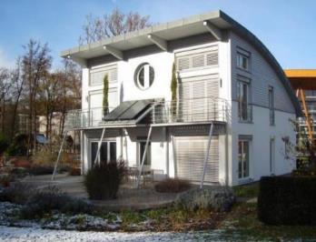


An international Standard
Developed by Dr. Wolfgang Feist and Prof. Bo Adamson in the 1980s
Over 60,000 Passivhaus projects have been completed world-wide.
Passivhaus is now the world’s leading international low-energy standard.
It is a building concept that can be adopted by anyone

Slide 8
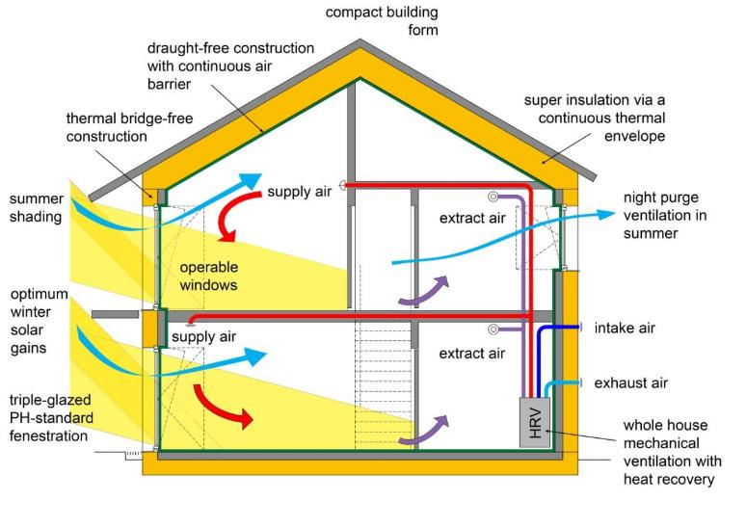
Passivhaus principles
Notes:
Space heat demand = certified through PHPP. May still possible to certify if this figure is over 15 as long as peak heat load is 10 W/m2 or less.
Pressure test = result of test / certificate as proof.
Primary energy = certified through PHPP.
Frequency of overheating = certified through PHPP.

Slide 9
Balanced energy use
Ventilation
Heating
15 kWh/m2.year
??
Infiltration
Thermal Bridges
Walls
Solar Gains
Floor
Roof
Internal Gains
Windows & Doors

Slide 10
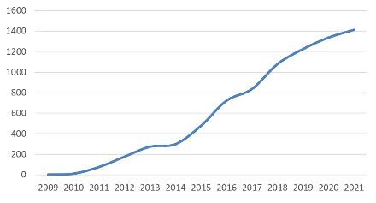
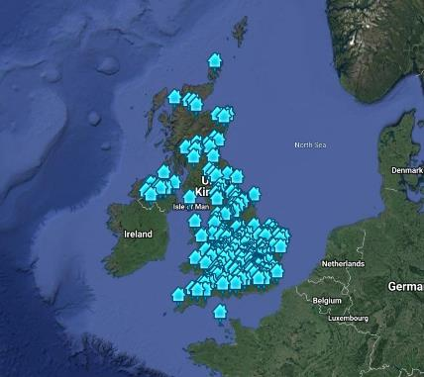
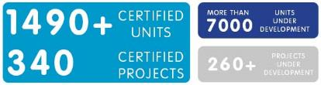
UK Passivhaus 2022
>1490 complete, > 7000 underway
passivhausbuildings.org.uk
Case studies can be viewed at: http://bit.ly/PHTprojects
Notes:
All that has led to this position/ activity for PH in the UK.

Slide 11
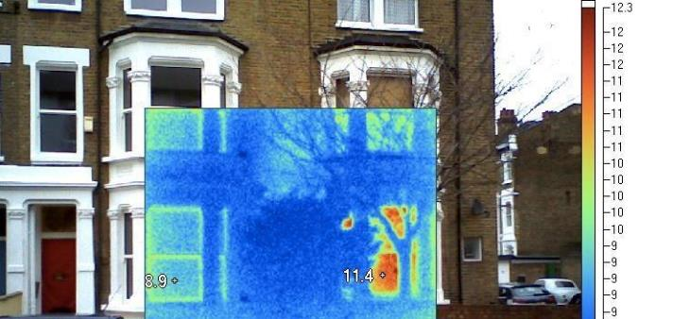
Also applies to refurbishment
“Quality-Approved Energy Retrofit with Passive House Components”
The goal was to create a standard for an economically and ecologically optimal energy retrofit, for old buildings that cannot achieve Passive House Standard with reasonable effort. (PHI)
Lena Gardens

Slide 12
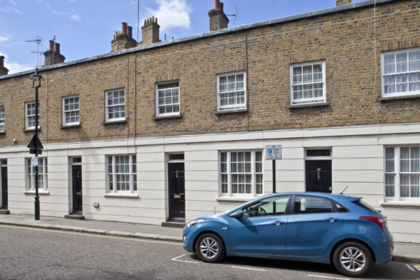
Multiple single-dwelling retrofits
e.g. Passmore Street, Grosvenor Estates
Notes:
And imaginative practitioners have even persuaded leading clients to trial EnerPHit on individual dwellings, such as Passmore Street.
Although these are successful, my concerns still remain that this is not a cost-effective solution in most cases due to cost.
The reason that it worked on these schemes was because of their price (millions) and the client’s willingness to pay the additional cost of EnerPHit, as they could recoup the costs in sale value because of Passivhaus’s status as a premium/ world-leading brand.

Slide 13
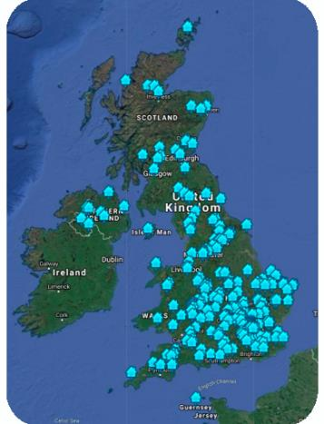
Passivhaus Retrofit 2022
Almost 100 units complete & certified
Ernerley Close the largest with 32 units
Approx 30 more underway
Notes:
All that has led to this position/ activity for PH in the UK.

Slide 14
Why choose Passivhaus?
Better Energy Performance
Greater Occupant Comfort
Comparable Capital cost
Lower running costs
Futureproof:
Passivhaus as a route to Net Zero
Quality now:
Passivhaus as a low risk approach

Slide 15
What you actually get …
73% lower
Lighting and Electricity
Domestic Hot Water
Space Heating

Slide 16
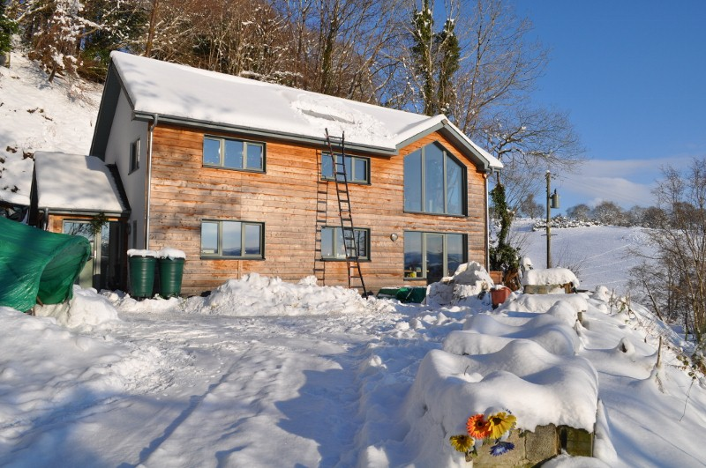
2011 Measured performance
Primary Energy: 100.19 kWh/(m².yr) (Everything, including space/water heating)
Space Heating: 8.86 kWh/(m².yr)
Y Foel, the first Certified PH project in the UK
North Wales (2006/7)
Notes:
This is Y Foel

Slide 17
EnerPHit – reduced emissions …
81% lower
48% lower
Lighting and Electricity
Domestic Hot Water
Space Heating
100m2 house = £140 p.a.

Slide 18
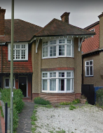
Passivhaus Retrofit
Small Retrofit Examples – Primary Energy
82% reduction
72% reduction
Example 1
Early 1900s solid wall semi detached 3-bed retrofitted to EnerPHit standard
Example 2
Detached 4 bed solid wall property to EnerPHit standard

Slide 19
Staged Retrofit
Allows for phased budgeting
Allows components to be replaced as they reach end of life
Removes the risk of Carbon Lock-in
Enables forecasting of future potential reductions

Slide 20
Underhill House: Seymour-Smith Architects

Slide 21
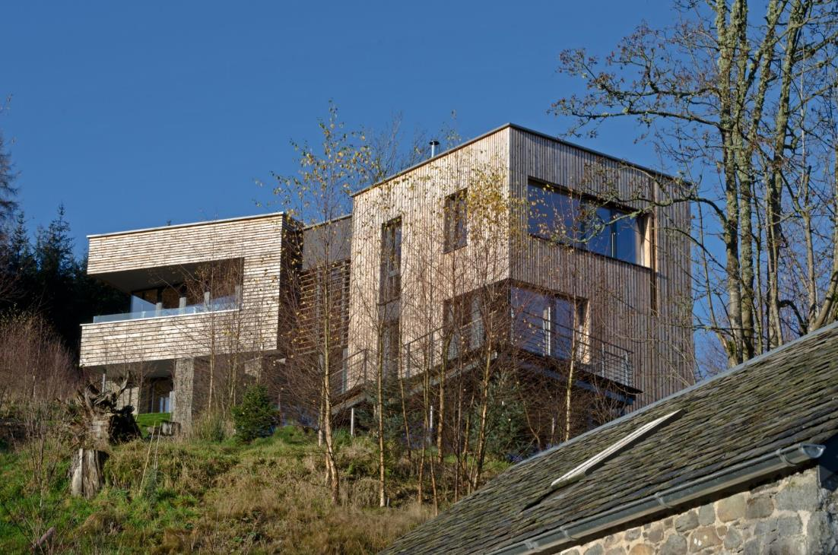
Plummerswood, GAIA Architects

Slide 22
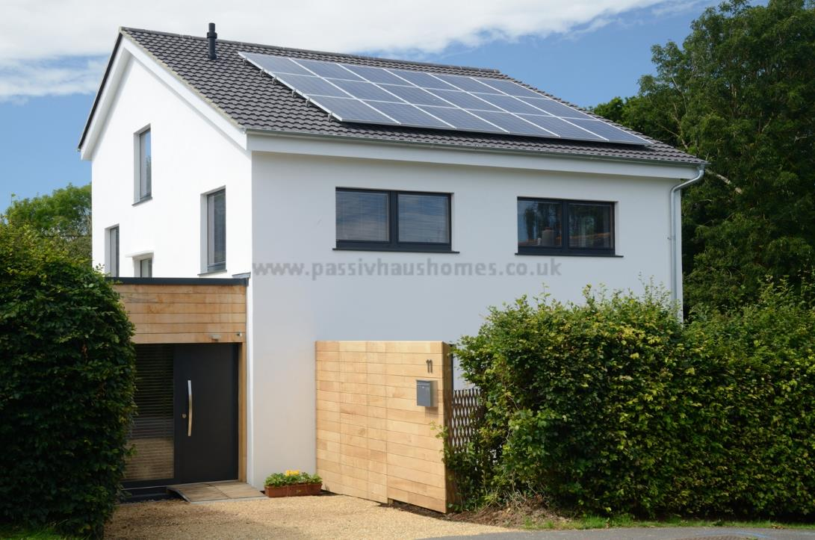

Slide 23
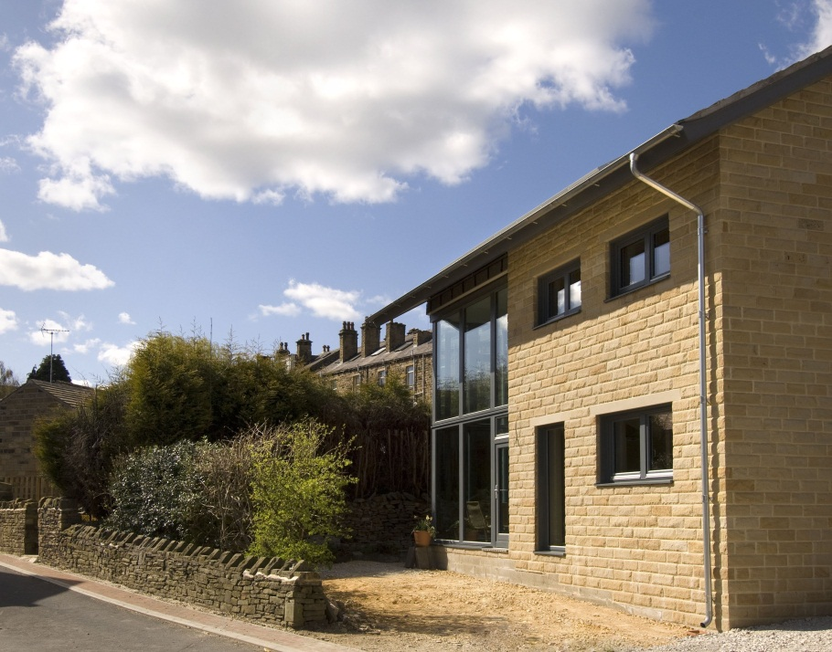
Denby Dale, Green Building Store & Derrie O’Sullivan Architects

Slide 25

Questions
Jon Bootland
jon@passivhaustrust.org.uk
Passivhaus Trust The Foundry, 5 Baldwin Terrace, London N1 7RU Tel: 0207 704 3502
Email: info@passivhaustrust.org.uk Web: www.passivhaustrust.org.uk
Erneley Close, Manchester : 2E Architects

Slide 26
Panel discussion

